Slide 1



Over View Information
Blue Prism
Pega Systems
Kofax
Pega is the leader in cloud software for customer engagement and operational excellence. Every day, Pega powers millions of automated processes, billions of customer interactions, and trillions of dollars of business by helping people open bank accounts, change phone plans, get healthcare, manage insurance claims, apply for permits, and more.
Our Intelligent Automation software platform helps organizations transform information-intensive business processes, reduce manual work and errors, minimize costs, and improve customer engagement
Blue Prism’s vision is to provide a Digital Workforce for Every Enterprise. The company’s purpose is to unleash the collaborative potential of humans, operating in harmony with a Digital Workforce, so every enterprise can exceed their business goals and drive meaningful growth, with unmatched speed and agility

Slide 2

Assist Edge RPA
Assist Edge is a leading cohesive automation platform built with a holistic suite of automation and AI capabilities. From automating repetitive manual tasks and improving data quality, to enhancing better customer experience, Assist Edge has got you covered. A leading automation tool, AssistEdge enables enterprises to realize the full potential of automation by assuring scalability, security, Intelligence, and Innovation.

Slide 3
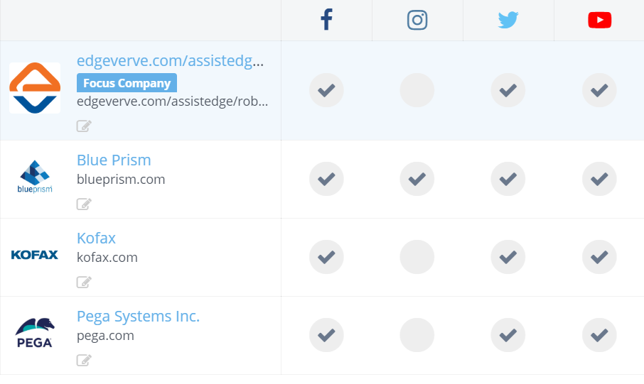
Social Media Presence OF All Four Companies
No of Followers | AssistEdge RPA | Pega system | Kofax | Blue prism
Facebook Page likes | 3036 | 57830 | 4820 | 1450
Twitter Followers | 6502 | 47651 | 6554 | 27664
Youtube Subscribers | 1450 | 9670 | 2070 | 6150

Slide 4
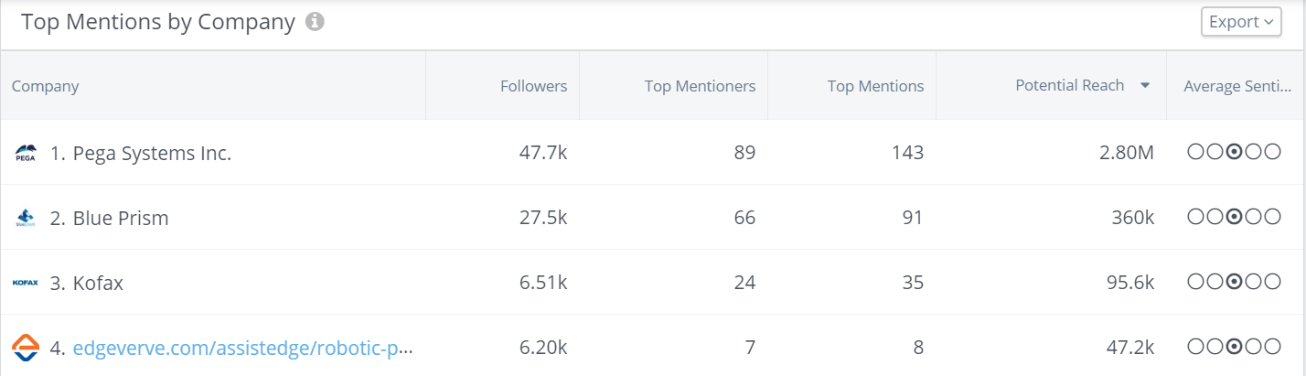
Twitter Presence and analysis

Slide 5
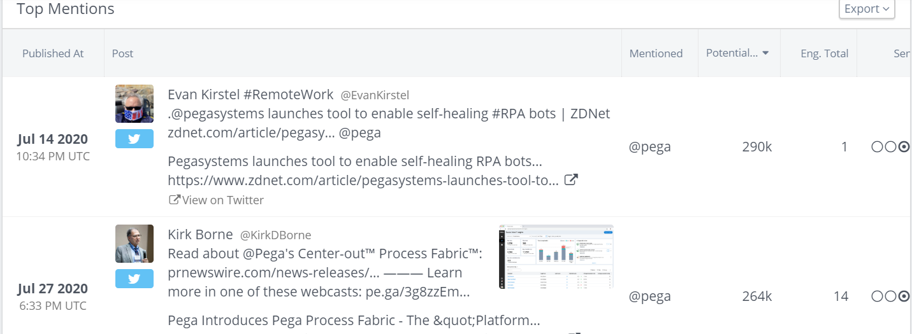
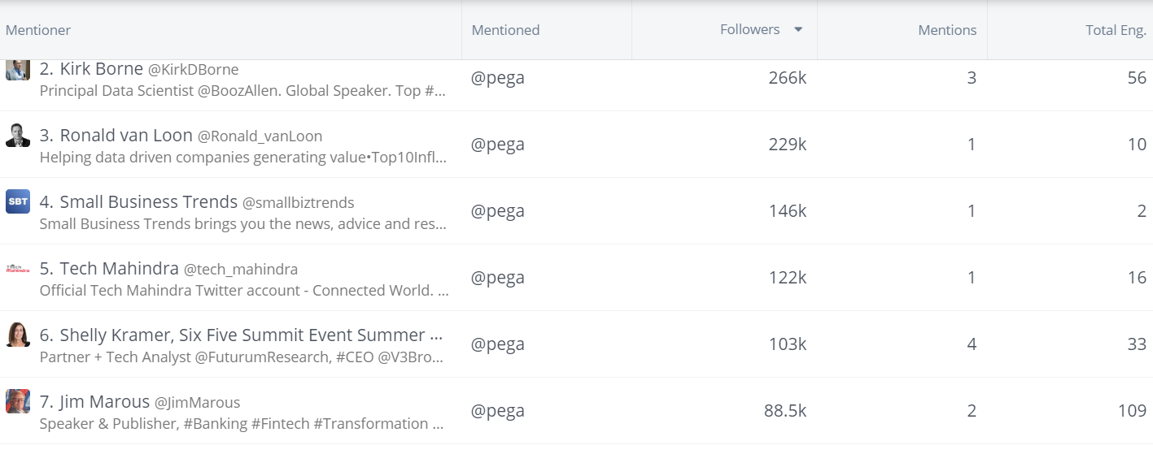
Pega systems Analysis
Posts per day-2.70
Eng rate-.018%
Posts with hashtags-38.3%
Posts type-2.27
Link-.030
Video-010

Slide 6
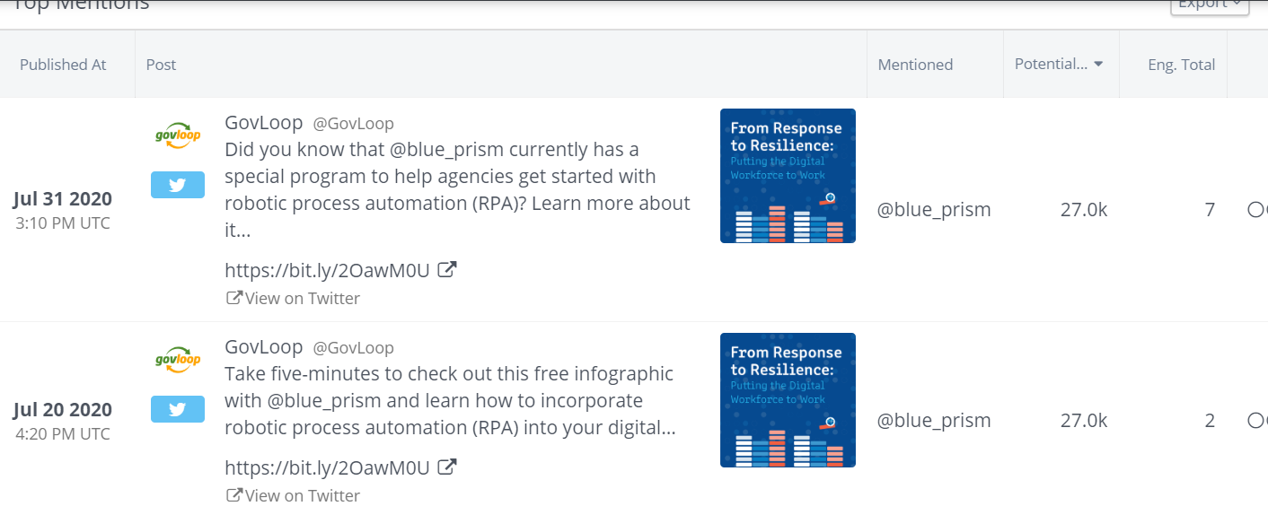
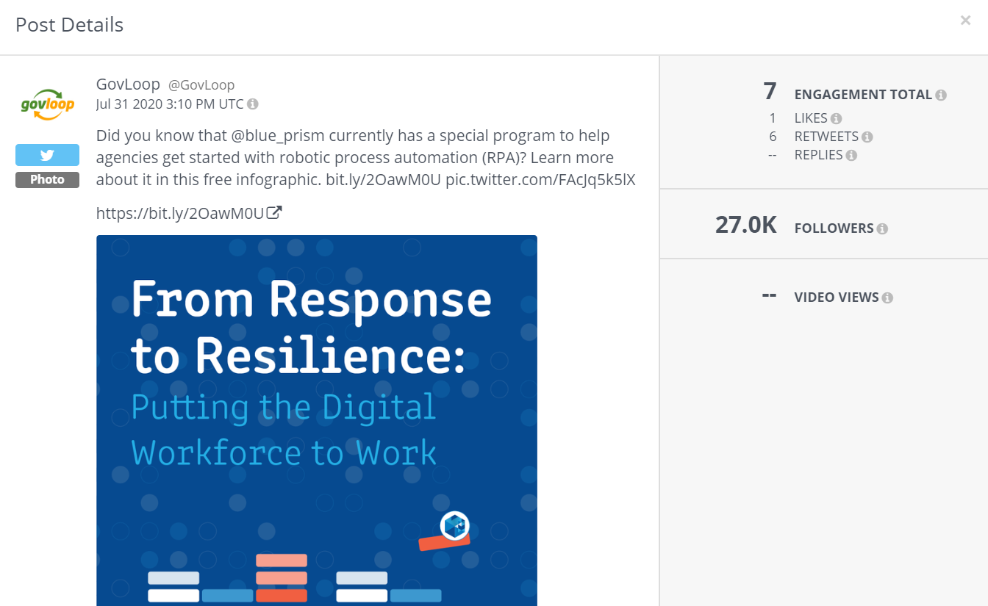
Blue Prism
Posts per day-1.57
Engagement rate-.036%
Posts with hash tag-93.6%
Top hour of day-7 am IST
common posts type-photo

Slide 7
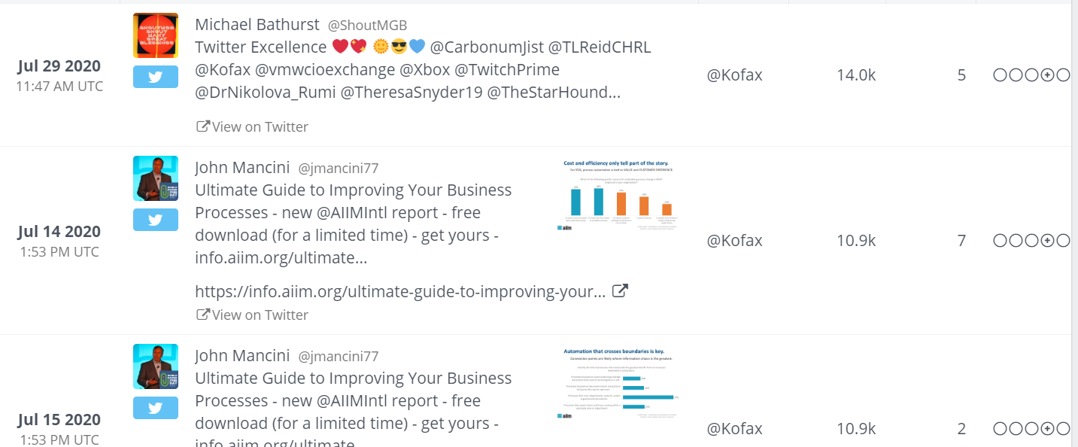
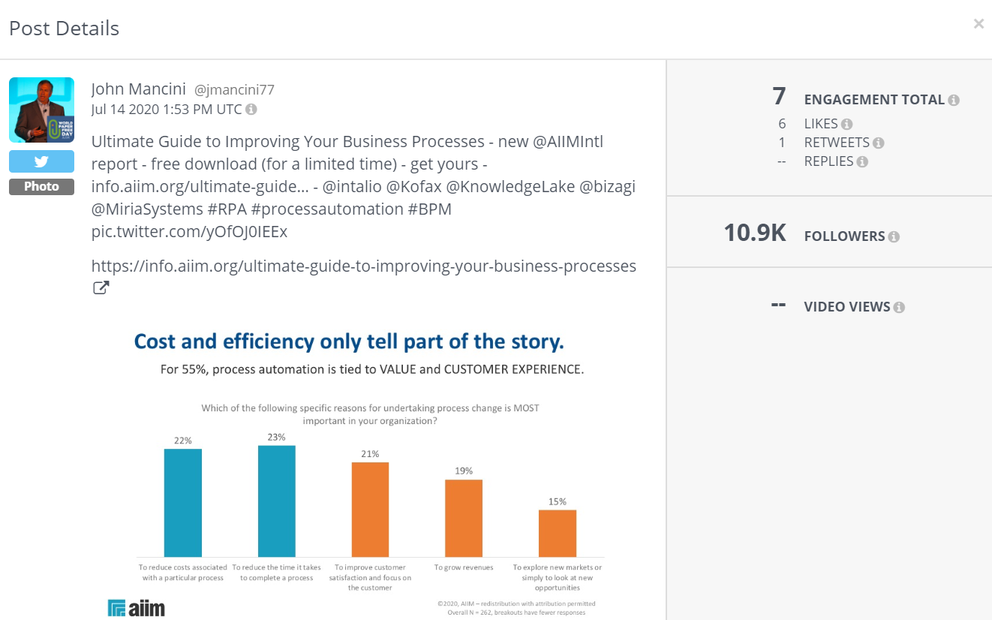
Kofax
Posts per day-.83
Eng rate-.55%
Posts with hashtags-100%
Posts type-Photo
Link-.067
Video-0.29

Slide 8
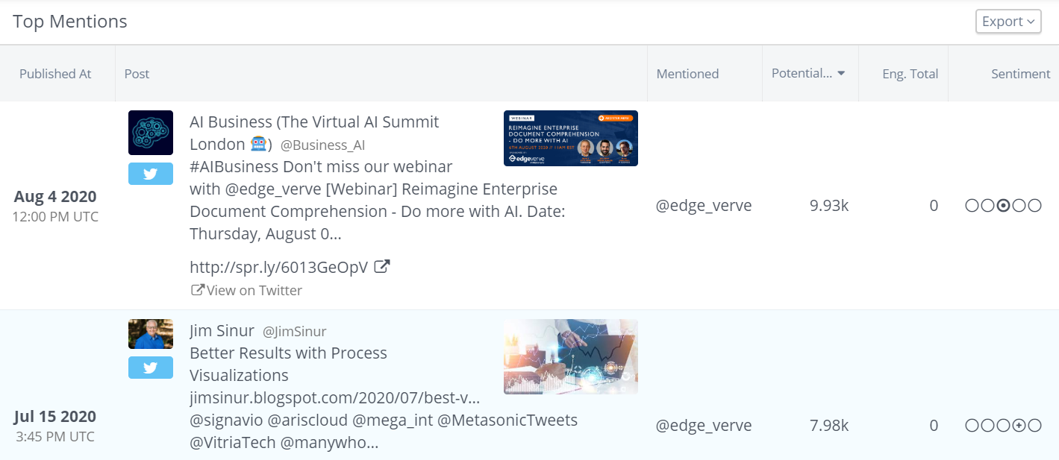
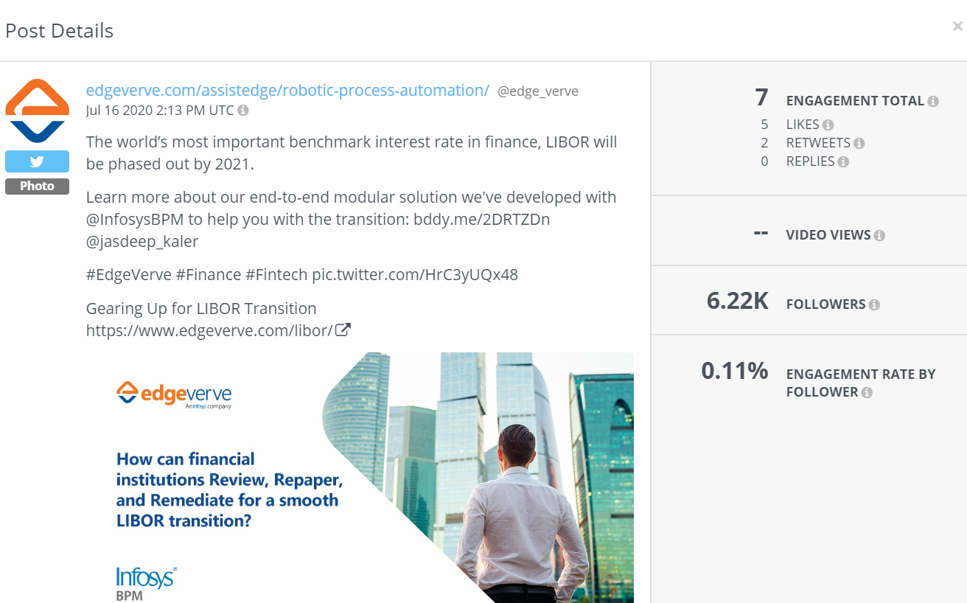
Assist Edge RPA
Posts per day-1.37
Engagement rate-.073%
Posts with hash tag-93.6%
Top hour of day-7 am IST
common posts type-photo
Engagement type- Link

Slide 9
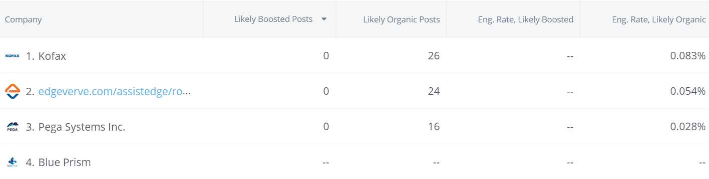
Facebook Analytics

Slide 10
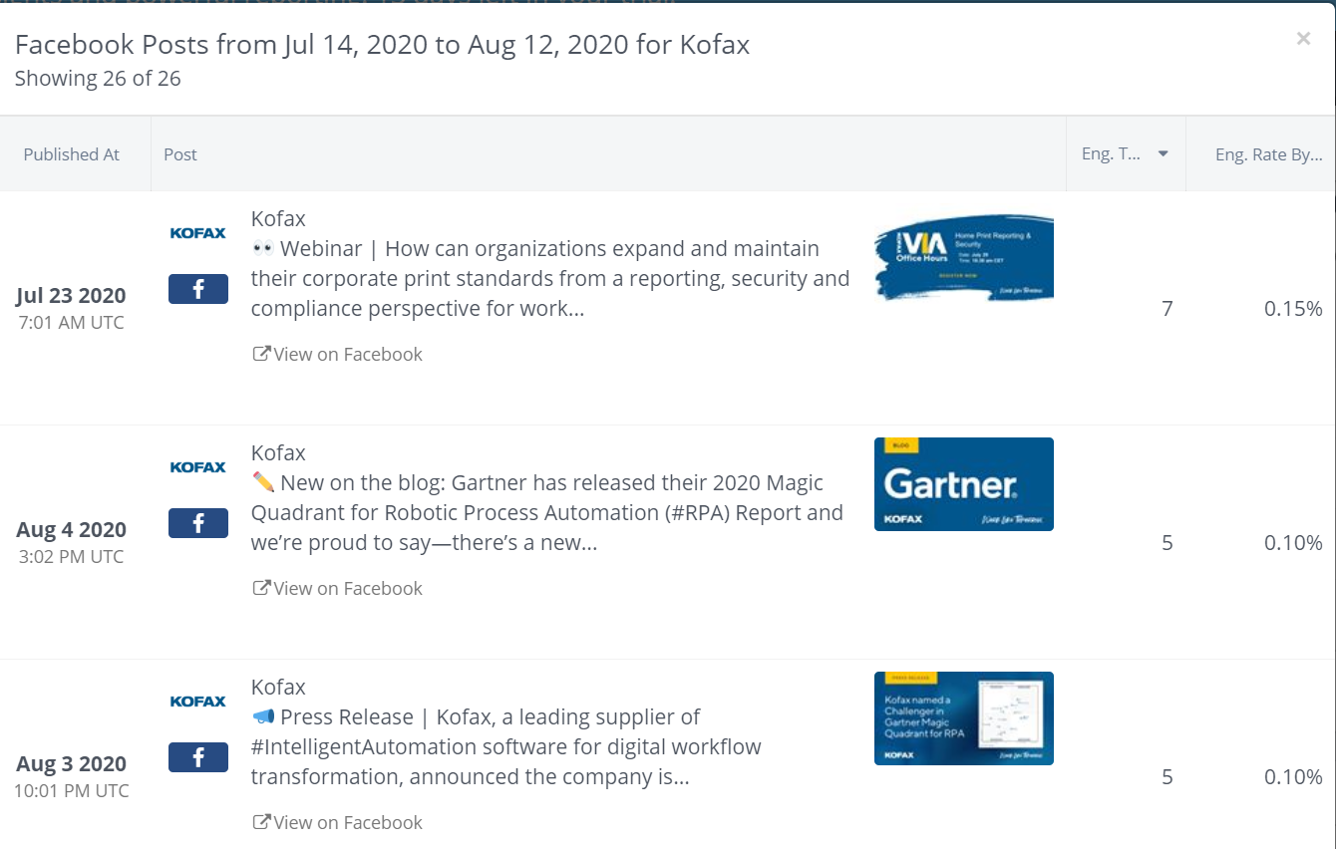
Kofax
No of followers-5159
Posts per day-.087
Posts Type-Photo
Posts with hashtags-92.835
Organic Posts-26

Slide 11
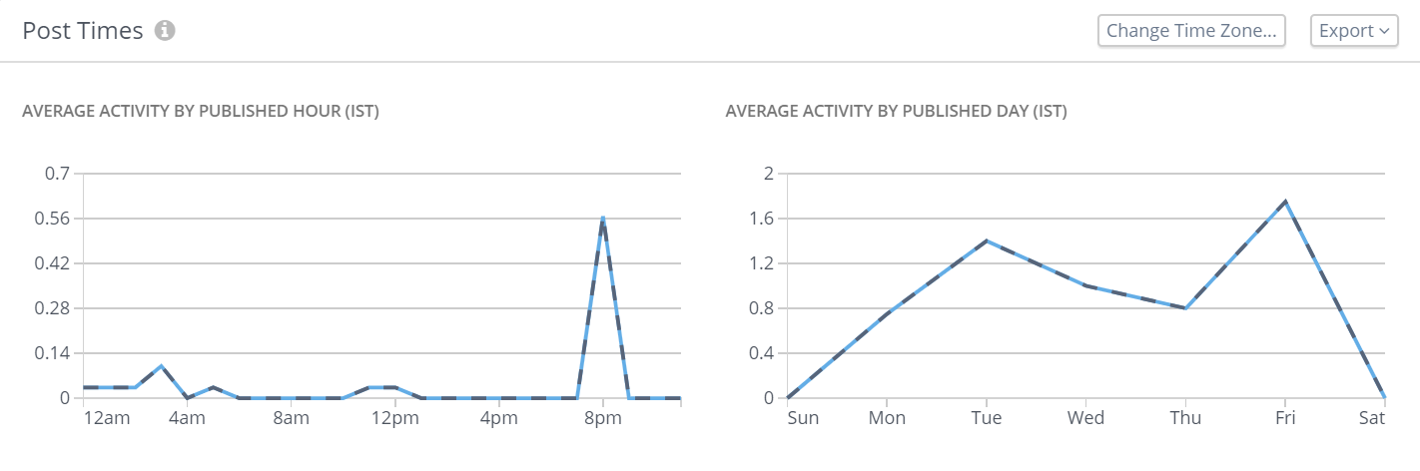
Posts Time Analysis
Most likely in to time zone @ 8 pm

Slide 12
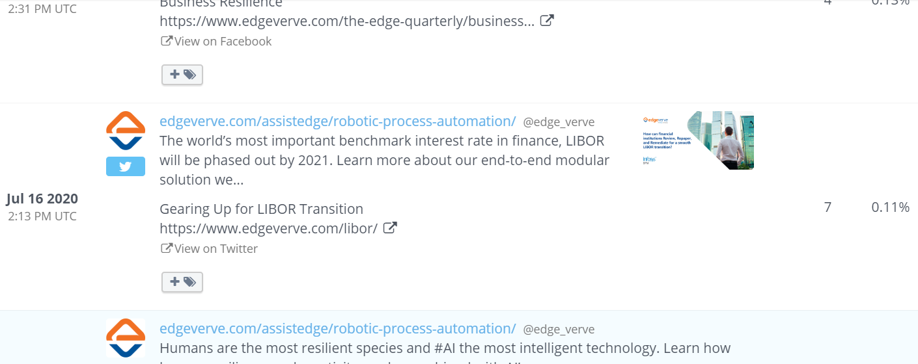
Assist Edge RPA
No of followers-3130 followers
Posts per day-1.5
Posts Type-Photo
Posts with hashtags-100%
Organic Posts-29
Link-.7

Slide 13
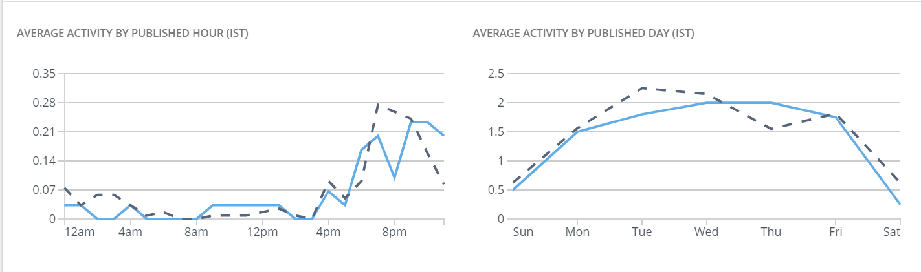
Posts time Ana lysis of Asset Edge RPA
4PM-8PM

Slide 14
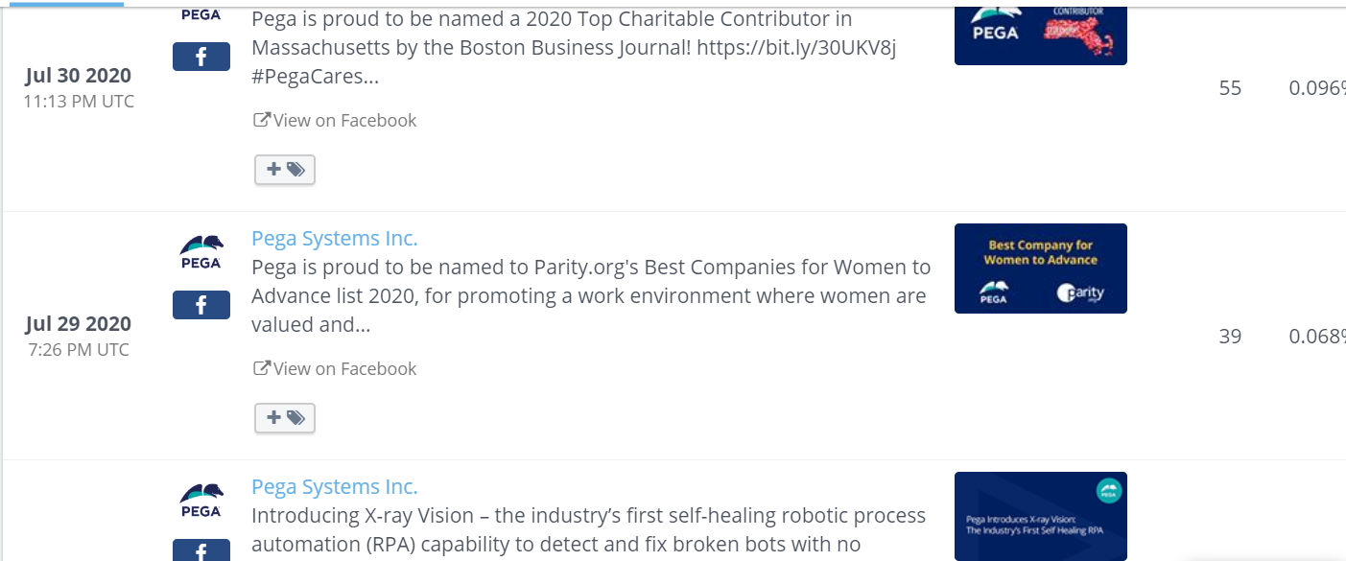
Pega System
No of followers- 57,150 Followers
Posts per day-1.24
Engagement rate-.028%
Posts Type-Photo
Posts with hashtags-18,8
Organic Posts-36
Link-..7

Slide 15
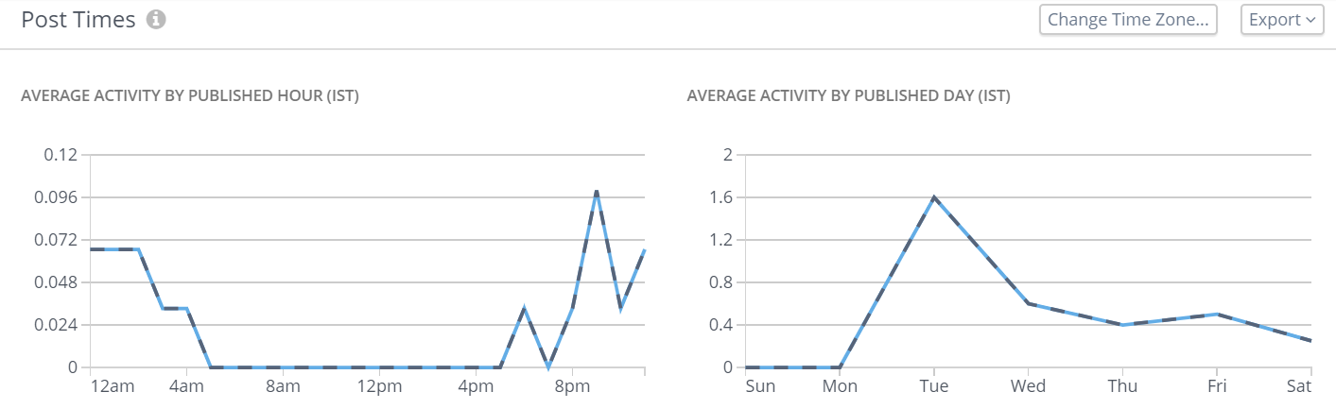
Pega systems
Most likely in to time zone @ 8 pm or after it.

Slide 16
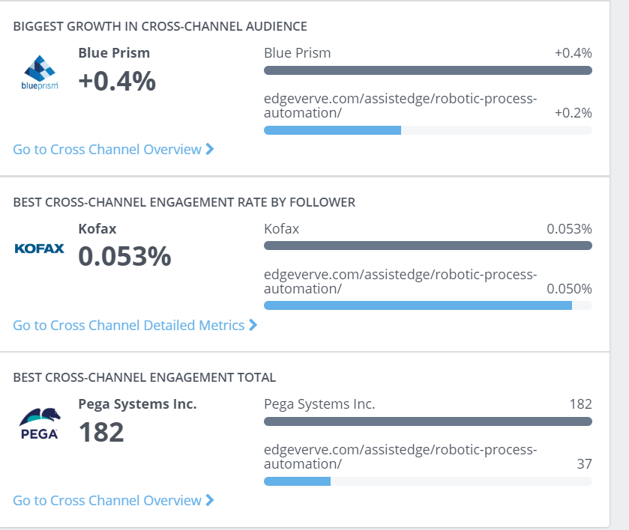
You tube Analytics

Slide 17
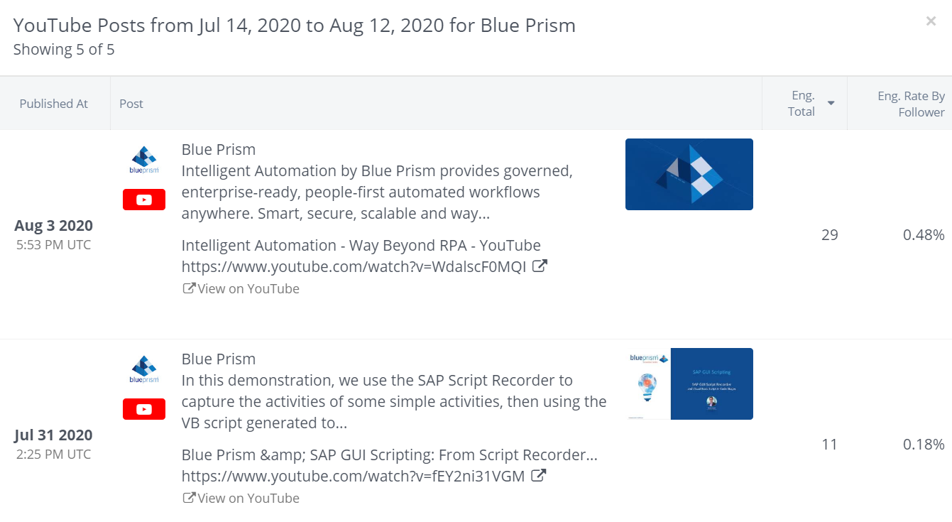
Blue Prism
No of subscribers
Eng. Rate by follower-.20%
Eng. Total/posts-12
Posts with hash tags-0%
Top hour of the day-11 pm
Posts per day-.17

Slide 18
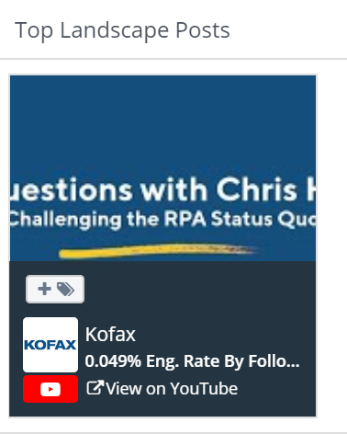
Kofax
No of subscribers-2.04 k
Eng. Rate by follower-.049%
Eng. Total/posts-6
Posts with hash tags-0%
Top hour of the day-1 am
Posts per day-.03
Posts Type-Video

Slide 19
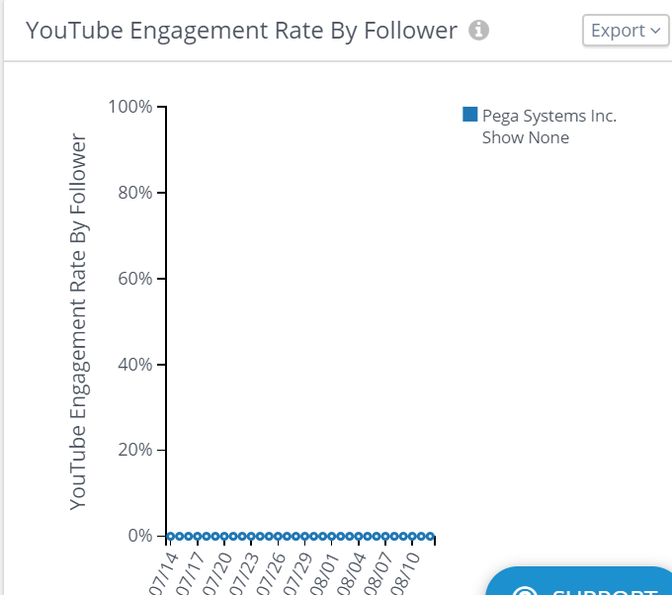
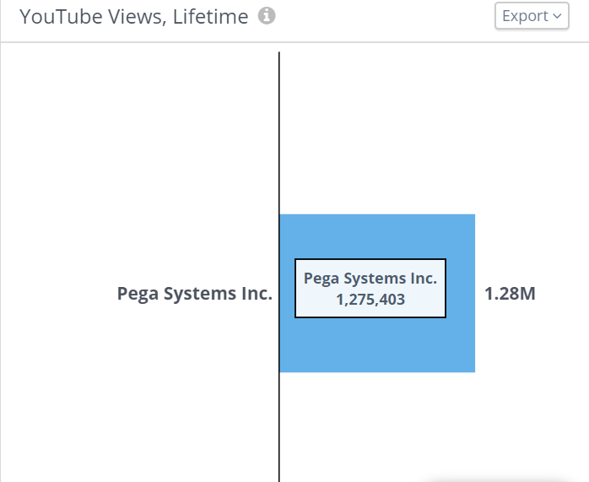
Pega Systems
Posts per Day: 0.10
Eng.Rate: 0.087%
Posts with HashTag: 0%
Top Hour of Day: 08:00 pm IST
Top HashTags: None
Most Common Post Type: Video
Post type with highest engagement: Video

Slide 20
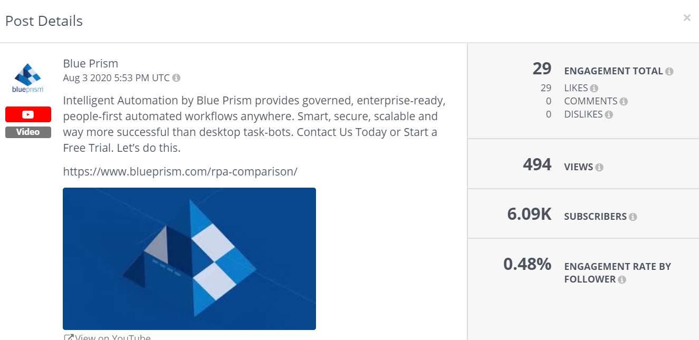
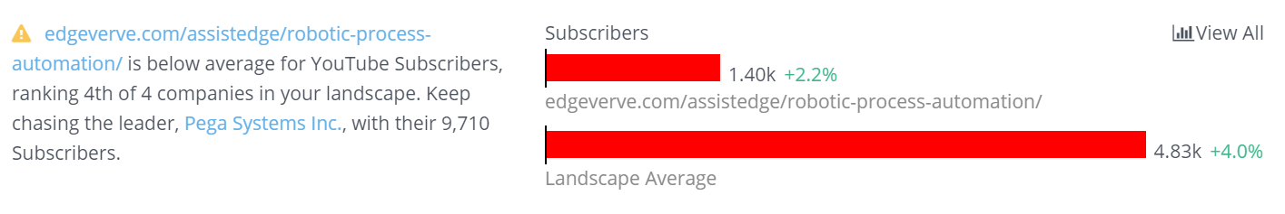
Assist Edge RPA
Posts per Day: 0.07
Eng.Rate: 0.11%
Posts with HashTag: 0%
Top Hour of Day: 03:00 pm IST
Top HashTags: None
Most Common Post Type: Video
Post type with highest engagement: Video

Slide 21
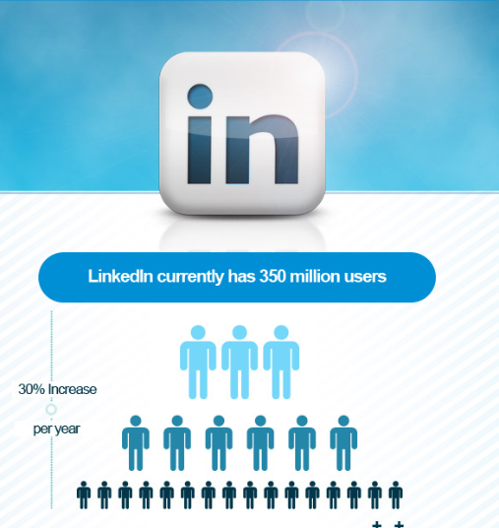
LinkedIn Analysis

Slide 22

Kofax
No of Followers-30450
Community hashtags-digital transformations

Slide 23
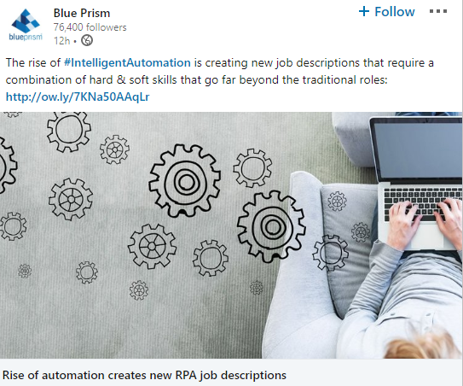

Blue Prism
No of Followers-77300
Community hashtags- Intelligent automation

Slide 24


Pega Systems
No of followers-215121
Community hashtags- inspire at pega20202

Slide 25
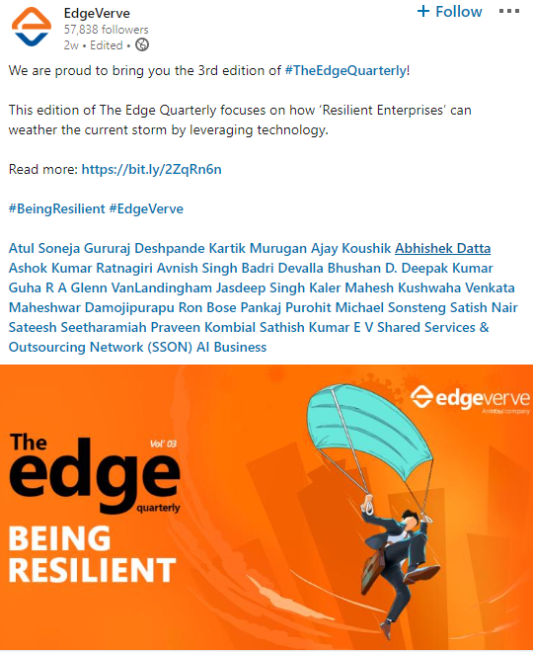
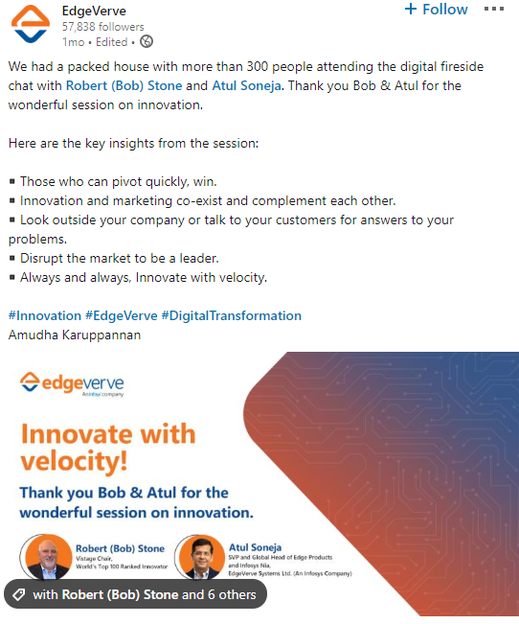

Assest Edge RPA
No of followers-57992
Community hashtags- automation, process automation

Slide 26
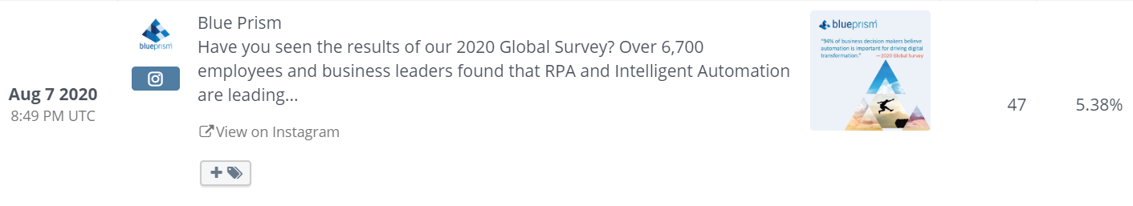
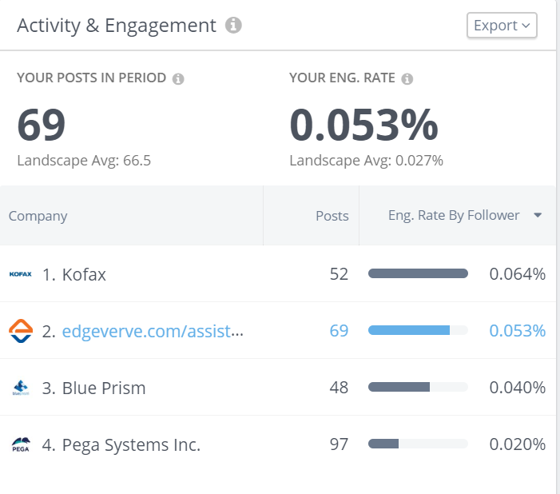
Total Landscape Measurement For Social Media Volume

Slide 27
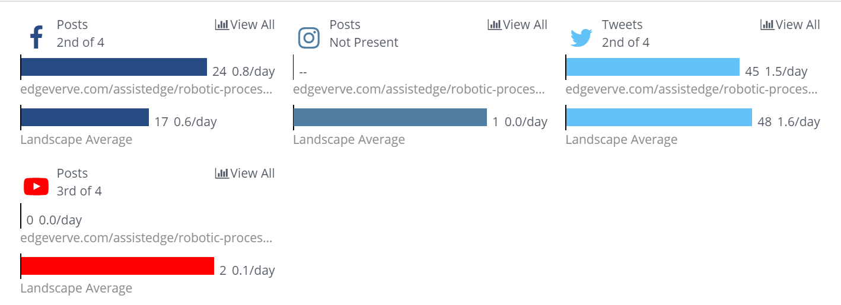
Social Activity Breakdown
Pega systems leads the position with97 posts while Assist Edge RPA holds 2nd rank.
Social Activity Breakdown | AssistEdge RPA | Pega system | Kofax | Blue prism
Facebook(Facebook Posts) | 25(-30.6%) | 16(+14.3%) | 27(-3.5%) | 0
Twitter(Tweets) | 47(+27%) | 83(-13.5%) | 26(-10.3%) | 44(-10.2%)
YoutubeVideos | 0 | 0 | 1 | 5(+150%)
Instagram | no | no | no | 1

Slide 28
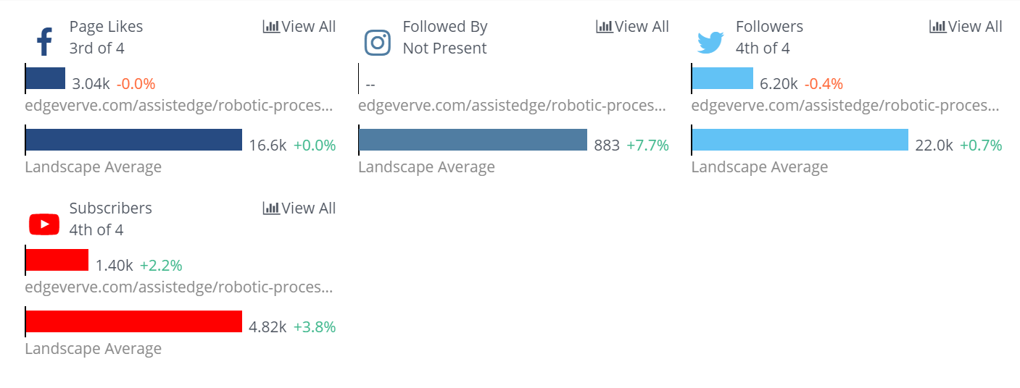
Social Media Audience analysis
Pega system leads with 11,231 audience while Assist Edge RPA rank last among all 4
Social Audience | AssistEdge RPA | Pega system | Kofax | Blue prism
Facebook Page Fans | 3.04 k(-.066%) | 57.0k(+.0289) | 4.83k(+041%) | 1.46k(+0.69%)
Twitter Followers | 6.20k(-0.37%) | 47.7k(+0.023%) | 6.51k(+0.31%) | 27.5k(+2.25%)
Youtube Subscribers | 1.40k(+2.94%) | 9.76k(+5.22%) | 2.07k(+1.47%) | 6.15k(+2.67%)
Instagram Followers | 0 | 0 | 0 | 882(+7.69%)

Slide 29
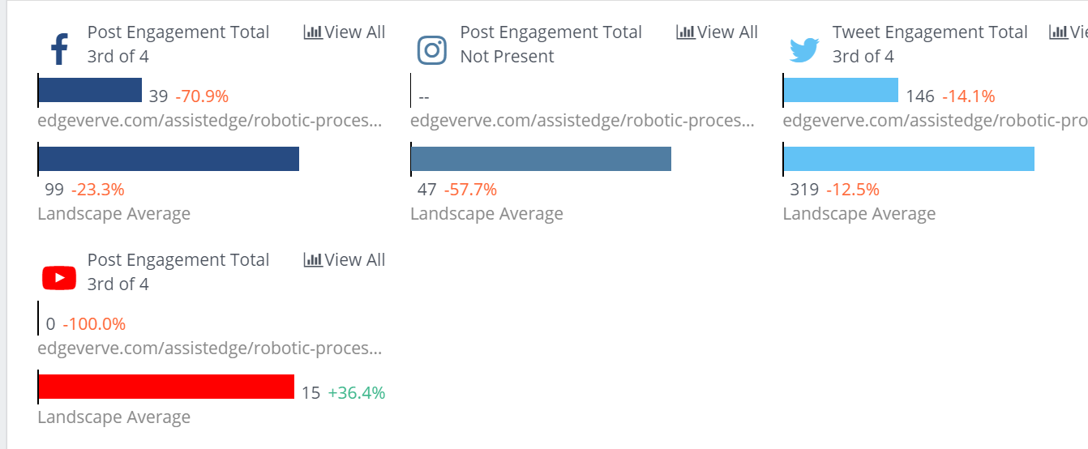
Social Engagement Breakdown
Pega system leads with 953 interactions as per cross channels analysis, where as Assist Edge RPA holds 3rd position in regards to total social engagement ranking)
Landscape Analysis for social media volume | AssistEdge RPA | Pega system | Kofax | Blue prism
Social Engagement Breakdown
Facebook | 43(66.9% decrease) | 247 (3.14% decrease) | 109(16% decrease) | 0
Twitter | 154(-4.35%) | 706(+569%) | 85( +41.7%) | 402(-19.4%)
Youtube | 0 | 0 | 1 | 59(+29.4%
instagram | no presense | no presense | no presence | 47(-57.7%)

Slide 30
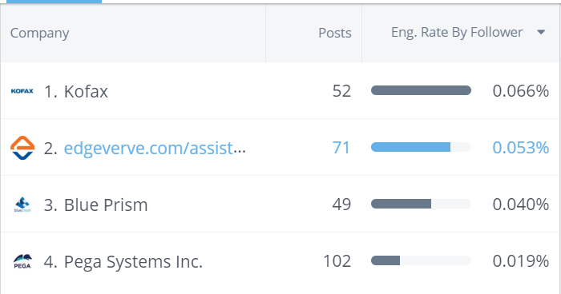
Metrices for review and social media analysis

Slide 31
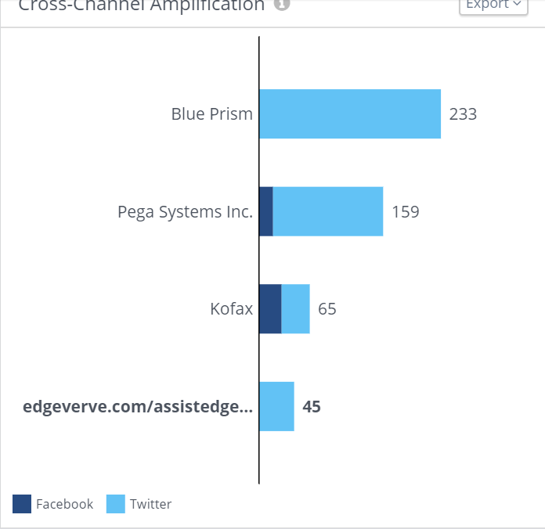
Cross Channel Amplification The social media channels amplification gives the insight of various posts engagement with other updates in regards to re-teweets/shares etc.
Cross Channel Amplification | AssistEdge RPA | Pega system | Kofax | Blue prism
Facebook | 0 | 162 | 70 | 265
Twitter | 47 | 18 | 32 | 0

Slide 32
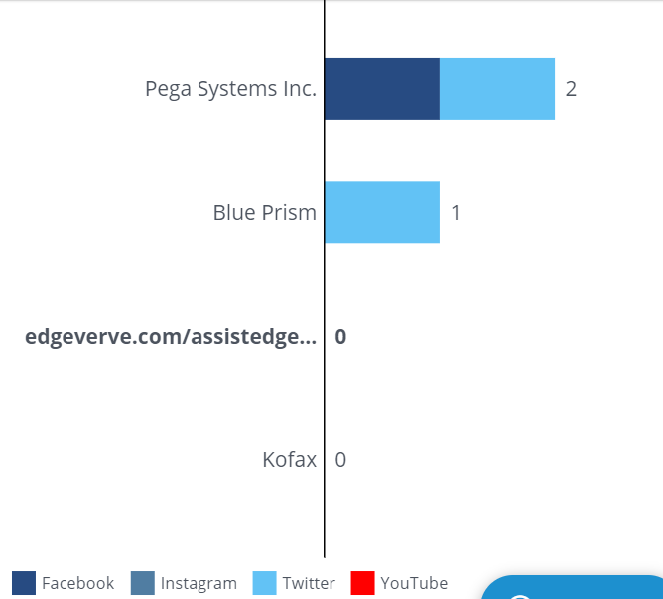
Cross-Channel Conversation
The customer engagement across all social media platforms indicate the customer interaction with highest number of interaction by Pega system
Cross Channel Conversation | AssistEdge RPA | Pega system | Kofax | Blue prism
Facebook | 0 | 1 | 0 | 0
Twitter | 0 | 1 | 0 | 1
Instagram | 0 | 0 | 0 | 0
Youtube | 0 | 0 | 0 | 0

Slide 33
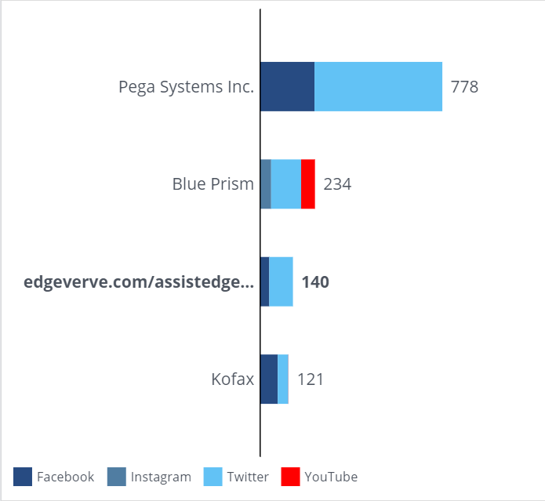
Cross Channel Applause
The tracking reports gives the analysis of positive reverts or appreciation by followers, fans, subscribers across all social media channels
Cross Channel Applause | AssistEdge RPA | Pega system | Kofax | Blue prism
Facebook | 43 | 789 | 77 | 136
Twitter |  | 228 | 47 | 42
Instagram | 107 | 0 | 0 | 57
Youtube | 0 | 0 | 1

Slide 34
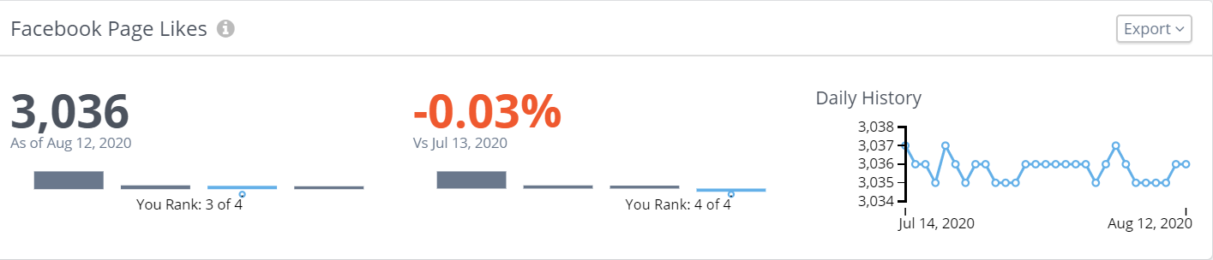
Ranking Analysis
Ranking Analysis | AssistEdge RPA | Pega system | Kofax | Blue prism
Facebook | 3 | 1 | 4 | 2
Twiiter | 4 | 2 | 1 | 2
Youtube | 4 | 1 | 2 | 3

Slide 35
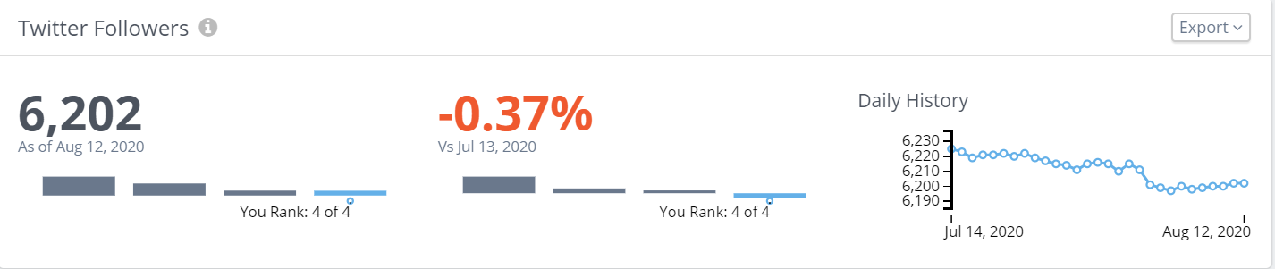
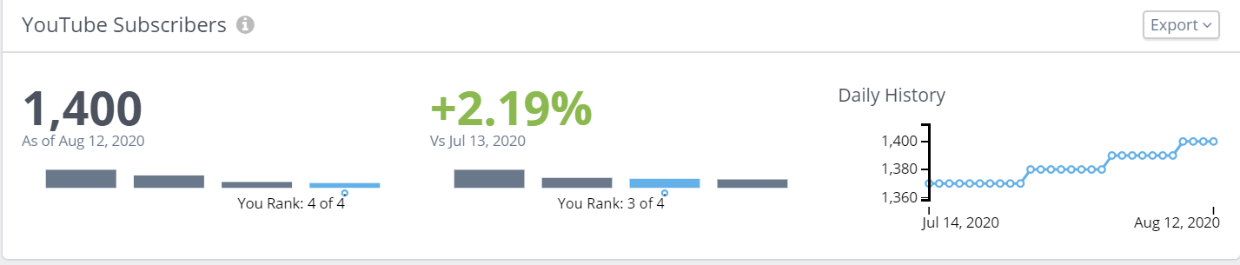
Rank Analysis on the basis of twitter followers and You tube subscribers

Slide 36
Common Hash Tags
#RPA
#DigitalTransformation
#AI
#MachineLearning
#IntelligentAutomation
#automation
#Gartner
#Fintech
#FutureofWork
#WFH
#healthcare
#BeingResilient
#TheEdgeQuarterly
#InfosysNia
#WorkLikeTomorrow
#AIPlatform
#Finance
#PegaWorld
#BluePrismCafe
#ComputerVision
#Whitepaper
#nextnormal
#AssistEdge
#DocAI
#EdgeVerve
#SupplyChain
#ThinkDifferent
#BusinessContinuity
#BusinessResilience
#DigitalWorkforce
#MagicQuadrant
#PegaCares
#webinar
#AISecurity
#AssistEdgeDiscover
#AutomationSingularity
#Banking
#EnterpriseAI
#FREE
#FinXEdgeCollect
#IAWeek
#IT
#InfosysBPM
#Innovation
#PDF
#ProcessDiscovery
#ProcureEdge

